Slide 1

EV Population Analyzing And Visualizing
By
Praveen Kumar Chidipothu,
Praveen Babu Narni
Ramakrishna Boggula
Trinadh Machanavazzala

Slide 2
Agenda
Introduction
5 V’s
Architecture
Goals
Conclusion
Presentation Title

Slide 3

Introduction
Electric vehicles are automobiles powered by electric motors, drawing energy from rechargeable batteries or other energy storage devices.
Environmental Benefits
Energy Efficiency
Reduced Dependence on Fossil Fuels
Lower Operating Costs.
Potential for Grid Integration

Slide 4

Analysis and Visualization Ideas
ROI
EV Market Share Over Time
Charging Infrastructure Distribution.
Environmental Impact Comparison.
EV Battery Technology Trends.
Consumer Preferences and Demographics.
Total Cost of Ownership Comparison
EV Adoption Policies and Incentives

Slide 5

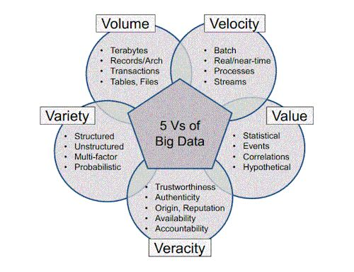

5V’s

Slide 6
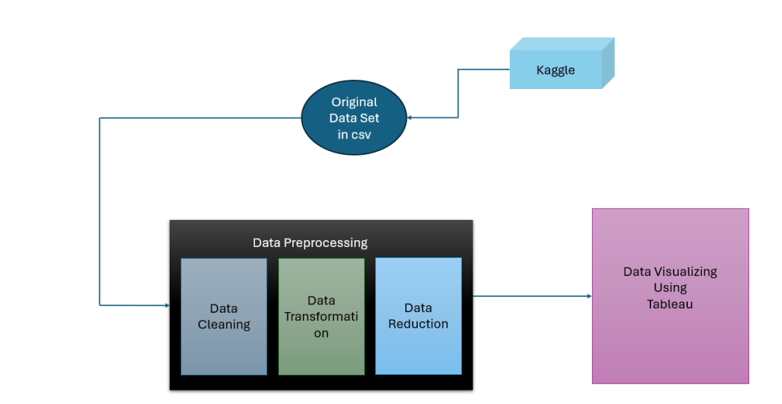
Architecture

Slide 7





Tools and Technologies

Slide 8

Areas of focus
Compare EV Adoption Rates Across Regions
Analyze Electric Vehicle (EV) Adoption Trends Model Year.
Total Count on EV vehicle sale till the date. ( Volume)
Examine Types of Electric Vehicles.
Comparing the average of electric range among the vehicles based in a particular period
Total Count on EV vehicle sale
Till the date.
Explore Price Sensitivity.

Slide 9


Conclusion
This PySpark project, integrated with Tableau for visualization, delves into an Electric Vehicle (EV) dataset. It analyzes EV adoption rates, sales trends, and vehicle characteristics, utilizing PySpark's DataFrame API for efficient data processing. The insights aid stakeholders in decisions regarding EV adoption, infrastructure investment, and market strategy, highlighting the importance of advanced analytics in advancing the electric vehicle industry.

Slide 10
Thank you
https://github.com/TrinadhM-dev/EV_PopulationDF.git

